Slide 1
Thermoelectric Effect
Muhammad Shamaas
2018-MS-EE-4

Slide 2
Thermoelectric Effect
Thermoelectric effect is the direct conversion of temperature differences to electric voltage and vice versa using a thermoelectric device.
It encompasses three separately identified effects:
Seebeck effect
Peltier effect
Thomson effect.

Slide 3
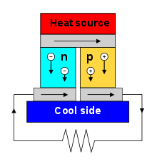

Seebeck Effect
Seebeck Effect explains the conversion of heat directly into electricity at the junction of different types of conductors.
$E_{EMF}=−S.∇T$
$S$= Seebeck Coefficient
$∇T$ = Temperature Gradient

Slide 4
Thermoelectric Generators (Seebeck Effect)
Thermoelectric generators are compact, expensive, inefficient and have no moving parts.
Power Recycling: Used in power plants for converting waste heat into additional electrical power.
ATEG: Automotive thermoelectric generators increase fuel efficiency by reusing waste heat.
Space probes: Radioisotopes are used in thermoelectric generators for heating.
Devices: Stove fans, body-heat powered lighting and smart watch, thermocouples, thermopiles and thermogalvanic cells.

Slide 5
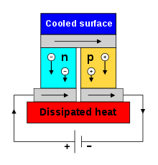

Peltier Effect
Peltier Effect explains the presence of heating or cooling at an electrified junction of two different conductors.
$\frac{dQ}{dt}={(Π}_{A}−Π_{B}).I$
$Q$ = Thermal Energy Produced
$I$= Current
$Π$ = $TS$ = Peltier Coefficient
of Medium

Slide 6
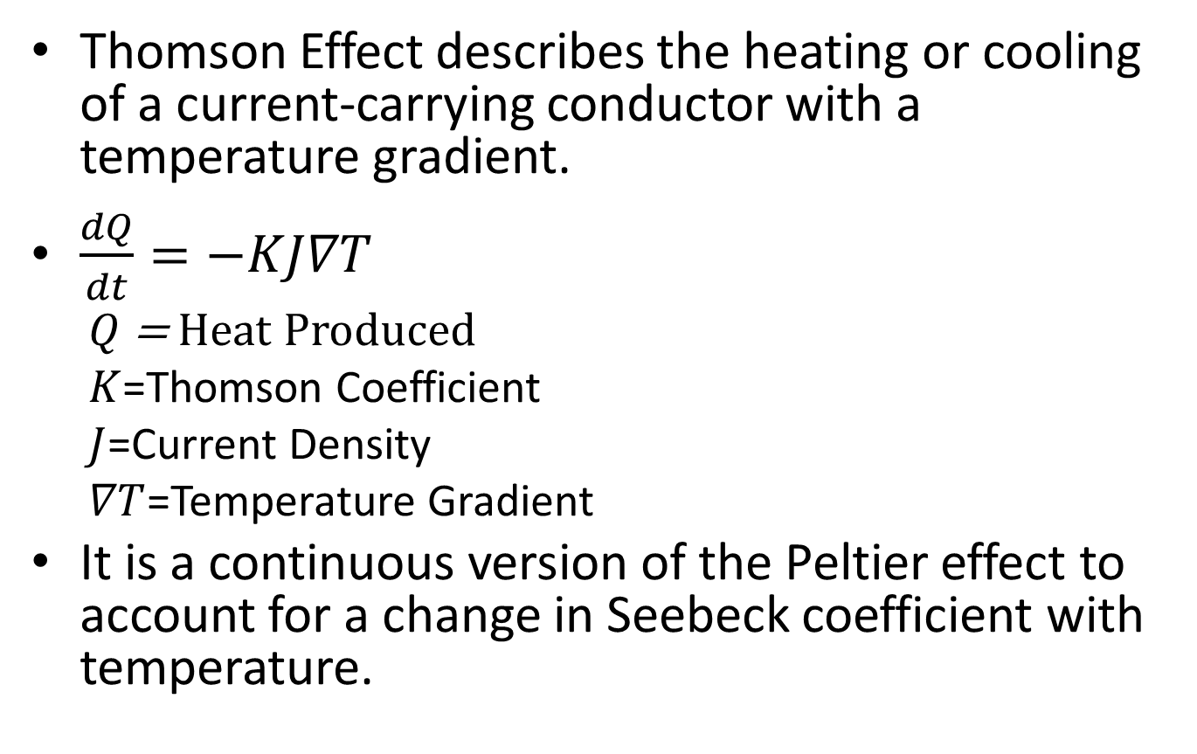
Thomson Effect
Thomson Effect describes the heating or cooling of a current-carrying conductor with a temperature gradient.
$\frac{dQ}{dt}=−KJ∇T$
$Q$ = Heat Produced
$K$=Thomson Coefficient
$J$=Current Density
$∇T$=Temperature Gradient
It is a continuous version of the Peltier effect to account for a change in Seebeck coefficient with temperature.

Slide 7
Thermoelectric Cooling (Peltier Effect)
Thermoelectric refrigerators: They are compact, have no circulating fluid or moving parts.
Thermal cyclers: Polymerase chain reaction (PCR) requires the precise, cyclic heating and cooling of samples to specified temperatures using Thermoelectric Coolers.

Slide 8
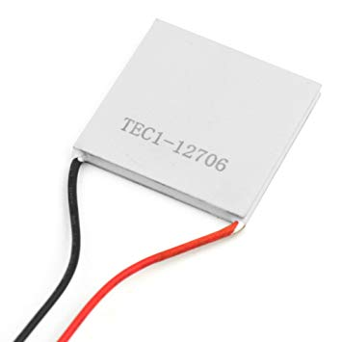
Manufacturing Thermoelectric devices
Material | Seebeck Coefficient
Selenium | 900
Tellurium | 500
Silicon | 440
Germanium | 330
Platinum | 0
Nickel | -15
Constantan | -35
Bismuth | -72
62mm X 62mm X 4.1mm
-50 °C – 100 °C
8.4V, 480W Generator

Slide 9
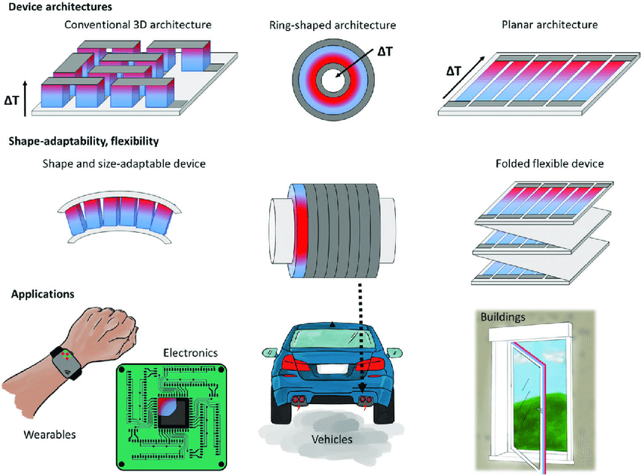

Slide 10
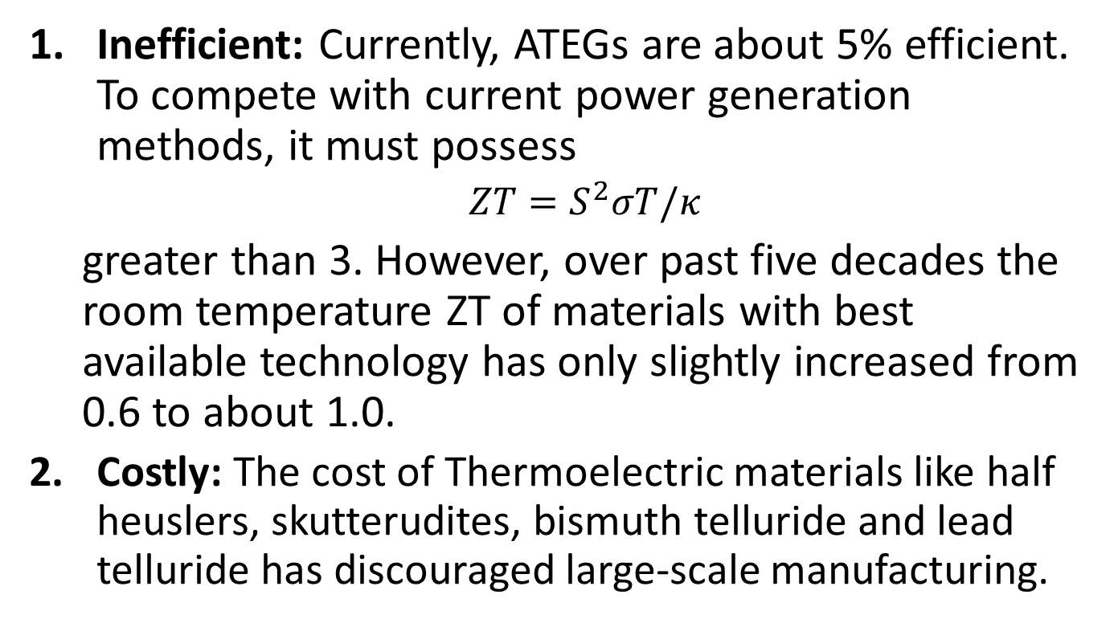
Challenges
Inefficient: Currently, ATEGs are about 5% efficient. To compete with current power generation methods, it must possess
$ZT=S^{2}σT/κ$
greater than 3. However, over past five decades the room temperature ZT of materials with best available technology has only slightly increased from 0.6 to about 1.0.
Costly: The cost of Thermoelectric materials like half heuslers, skutterudites, bismuth telluride and lead telluride has discouraged large-scale manufacturing.

Slide 11
Future of Thermoelectric Devices
Utilization of waste heat: Replacing the conventional electric generator with ATEGs means that the engine burns less fuel and releases fewer emissions. This could increase the fuel economy by up to 4%.
Hi-Z Inc. ATEG: The Generator produced 1 kW from a diesel truck exhaust system.
Advancements in thin-film and quantum well technologies: Low-cost production of tetrahedrite by Michigan State University, could increase efficiency up to 15% in the future.
Same efficiency at all power levels: More efficient than heat engines for low power applications (< 1kW).

Slide 12
References
[1] TEC1 Thermoelectric module. [Online]. Available: http://www.everredtronics.com/thermoelectric.TEC1.html. [Accessed: 15-Nov-2018].
[2] “Seebeck coefficient,” Wikipedia, 03-Nov-2018. [Online]. Available: https://en.wikipedia.org/wiki/Seebeck_coefficient. [Accessed: 15-Nov-2018].
[3] “Thermoelectric effect,” Wikipedia, 15-Aug-2018. [Online]. Available: https://en.wikipedia.org/wiki/Thermoelectric_effect. [Accessed: 15-Nov-2018].
[4] “Thermoelectric generator,” Wikipedia, 04-Nov-2018. [Online]. Available: https://en.wikipedia.org/wiki/Thermoelectric_generator. [Accessed: 15-Nov-2018].
[5] “Thermoelectric Generators,” Wireless Inductive Charging. [Online]. Available: http://large.stanford.edu/courses/2010/ph240/weisse1/. [Accessed: 15-Nov-2018].
[6] “What is a Thermoelectric Generator (TEG)? - Definition from Corrosionpedia,” Corrosionpedia. [Online]. Available: https://www.corrosionpedia.com/definition/4357/thermoelectric-generator-teg. [Accessed: 15-Nov-2018].

